Slide 1


MICHELLE JANUS
Creative Portfolio

Slide 2
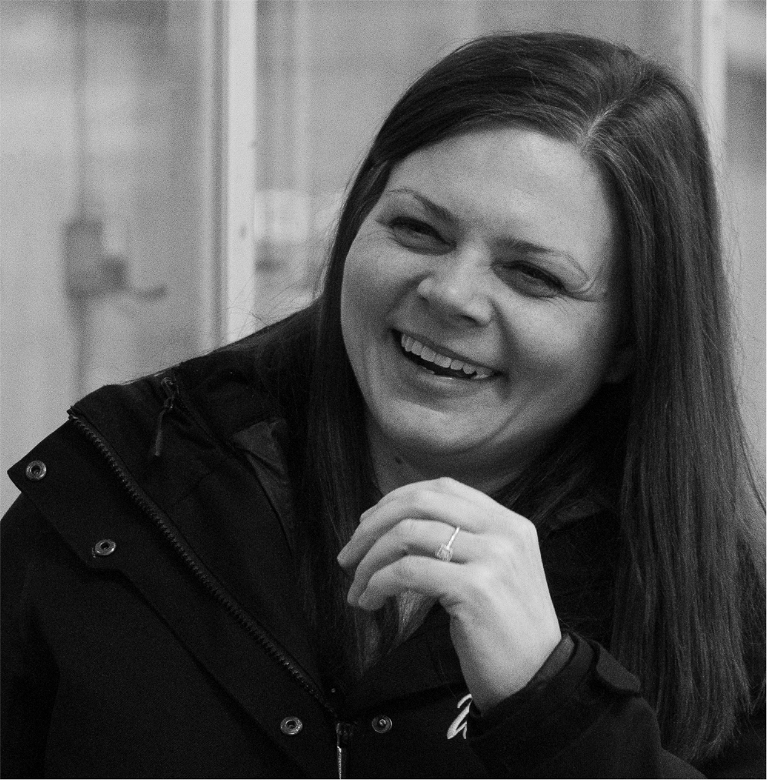
Michelle Janus
Graphic Designer
I have worked in female sports for fifteen years as a Coach and Media Specialist. I have a strong passion for sports as I find it rewarding to see athletes reaching their potential on and off the ice and I find it extremely rewarding to be a part of their journey.
My professional experience as a Graphic Designer includes digital and print media for applications on websites, social media, printed marketing materials and apparel.
My goal is to further develop my expertise and contribute to the growth and visibility of female athletes and sport through innovative and impactful designs.

Slide 3

NOTABLE
PROJECTS

Slide 4

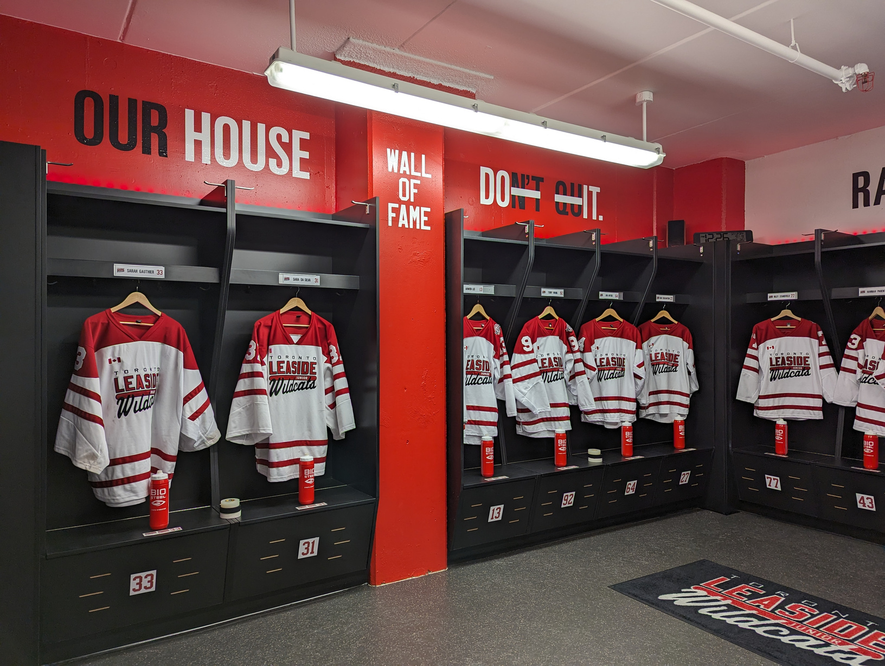

PROJECT
01
Locker Room Branding
Fundraising for a new locker room at Leaside Memorial Arena allowed for additional design ideas to be incorporated into the final project.
Wall Decals with inspirational quotes were added to the design. Also custom name plates with team logo and player name and number to each stall.
The room is currently used by the U22 Wildcats. All TLGHA High Performance teams were invited to tour the room and share in the experience of being a Jr Wildcat.

Slide 5
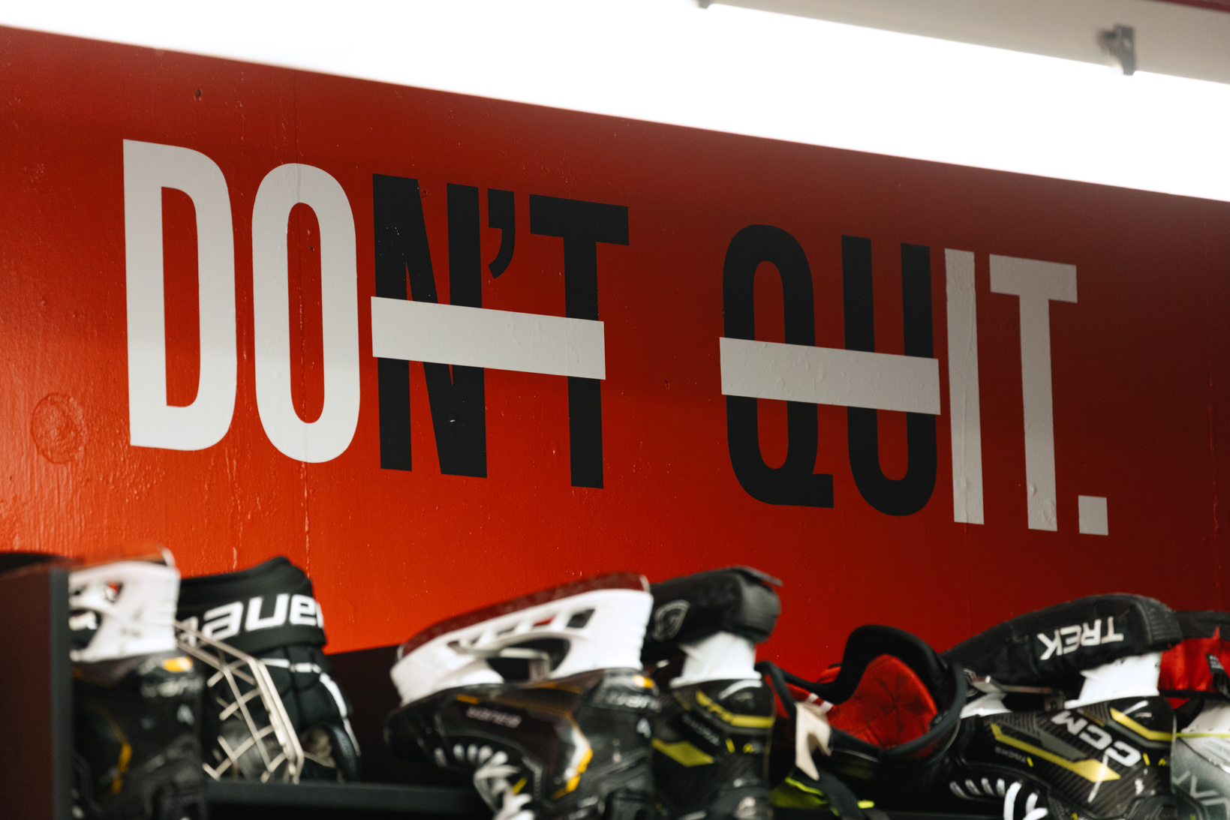
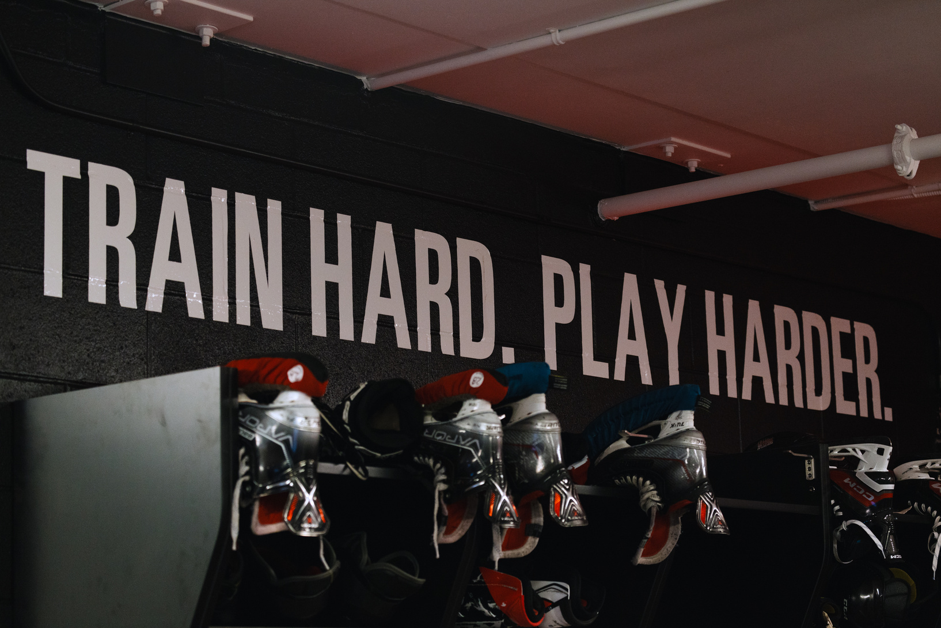
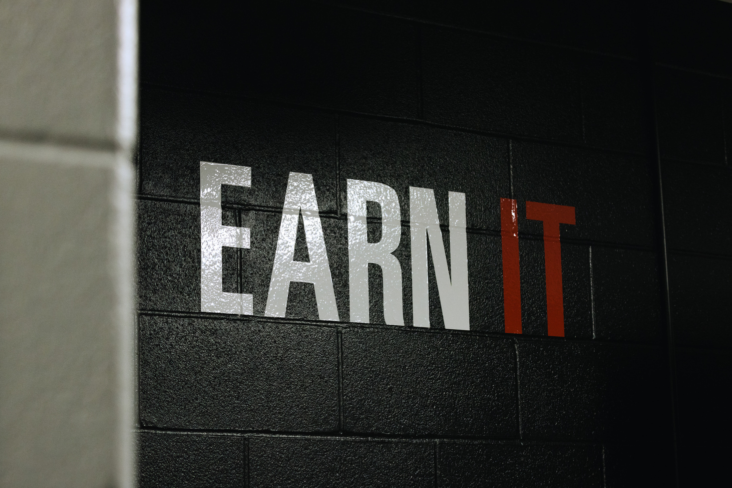
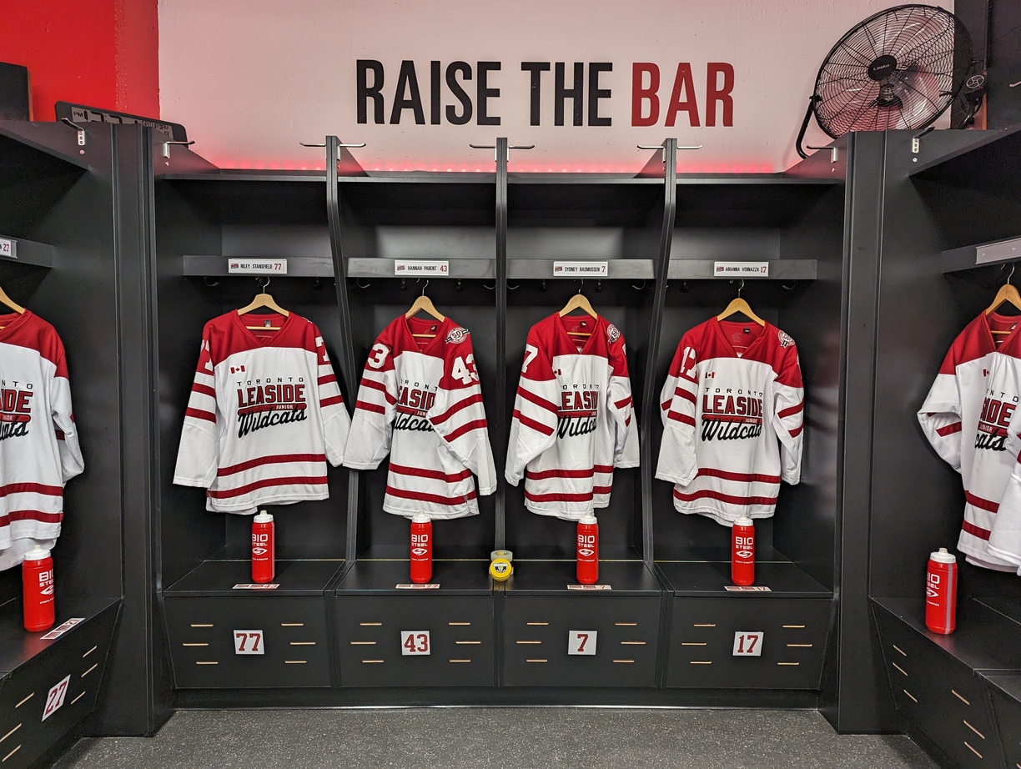
Locker Room Branding
I collaborated with the TLGHA and U22 players to select inspirational quotes that resonated most with the team, drawing from both our High Performance programming and quotes personally supported by the players.
The goal was to create decals that would reflect the drive and emotions that are associated with competing at the Elite level. To maintain consistency and ensure flexibility, the same font family was used across three colors, allowing for adaptable spacing and placement within the locker room.

Slide 6



PROJECT
02
Media Guides
The 24-page team media guides were thoughtfully designed to provide a detailed overview of the player roster.
These guides were strategically distributed to university scouts and coaches at home games and key showcase tournaments.

Slide 7
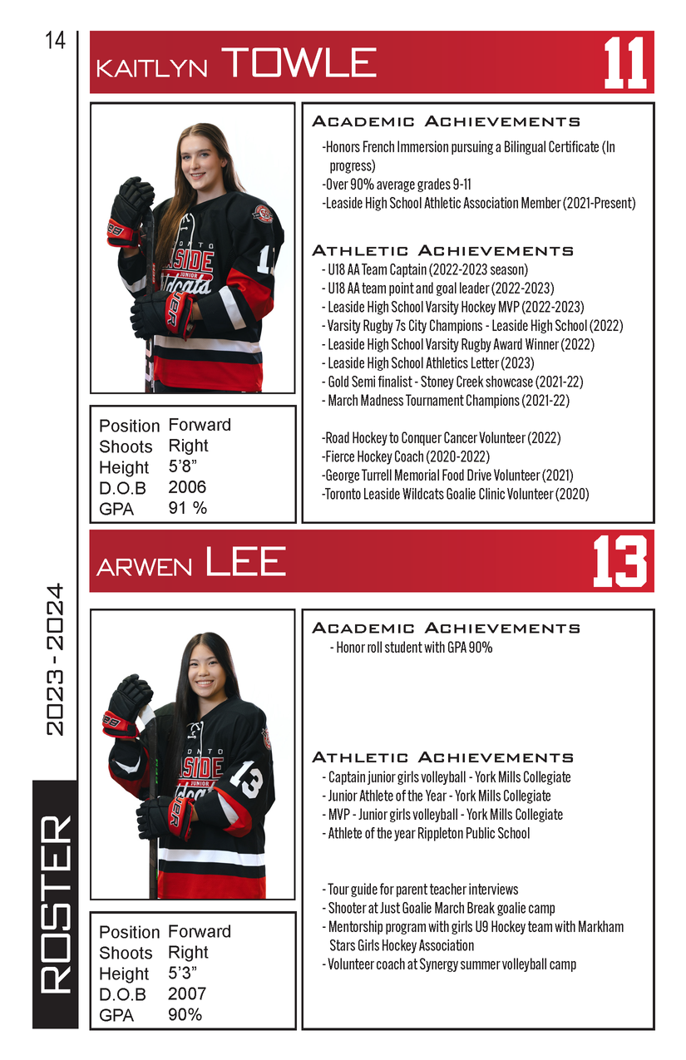
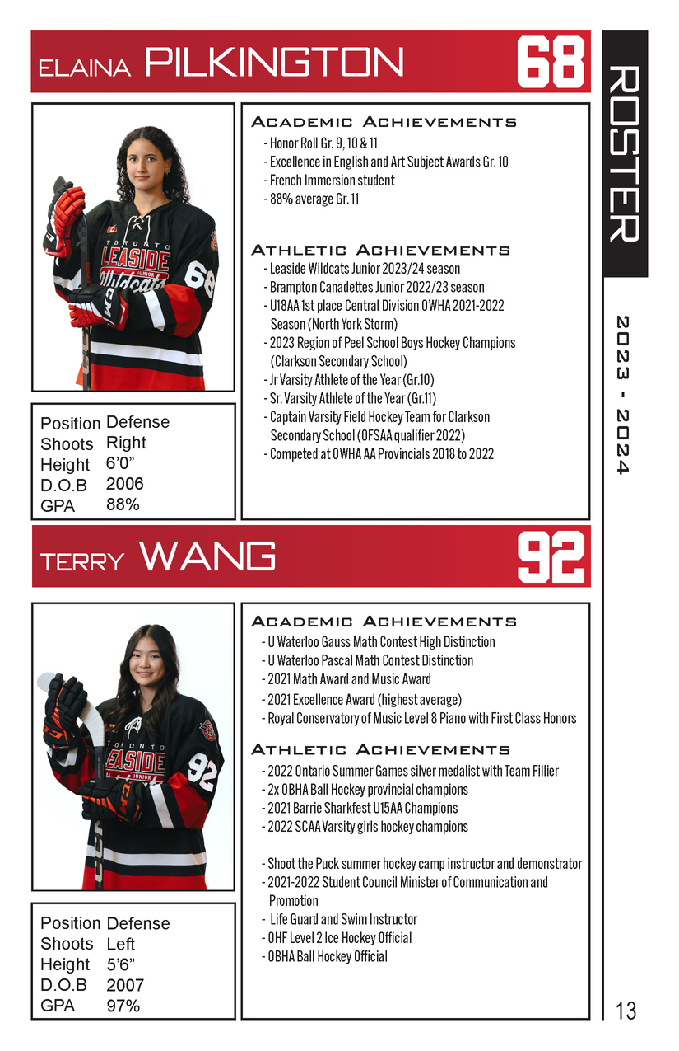
Media Guides
Adobe InDesign used to create the booklet and organize the document each season.
Player information was collected for each player and was organized for consistency.
Focusing on academic and athletic success to promote and highlight the players’ character and intangibles.

Slide 8
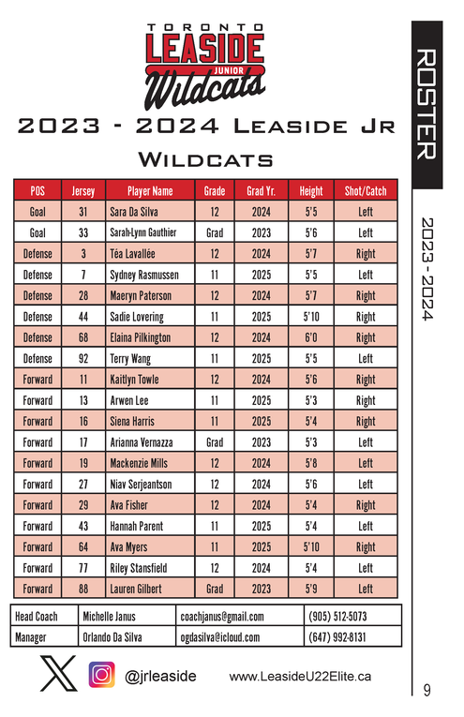
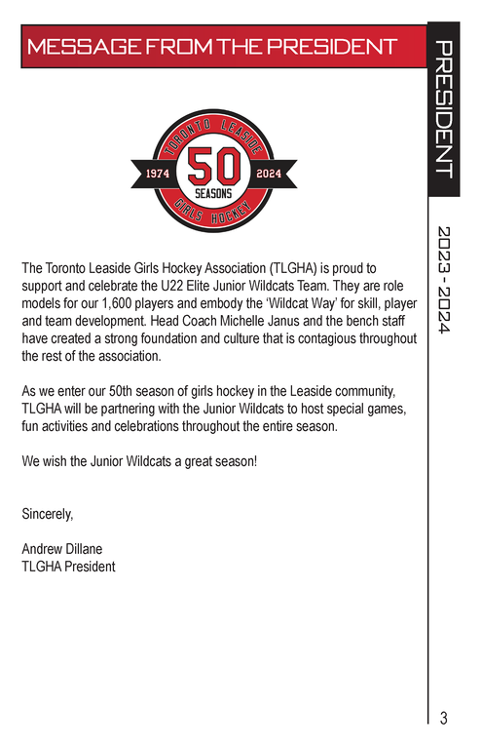


Media Guides
As the funding for this booklet was provided through team sponsorship, the player pages are surrounded by sponsorship acknowledgement and additional team details.
Including elements such as the team roster and a message from the president was crucial in emphasizing the team's values and identity.

Slide 9


PROJECT
03
Social Media
At STÄRK, part of the audience engagement was acknowledging major tournaments and congratulating teams who made it to those championship weekends.
Engaging with the audience on asking for tags to which teams they’re representing or who they’re cheering for.

Slide 10

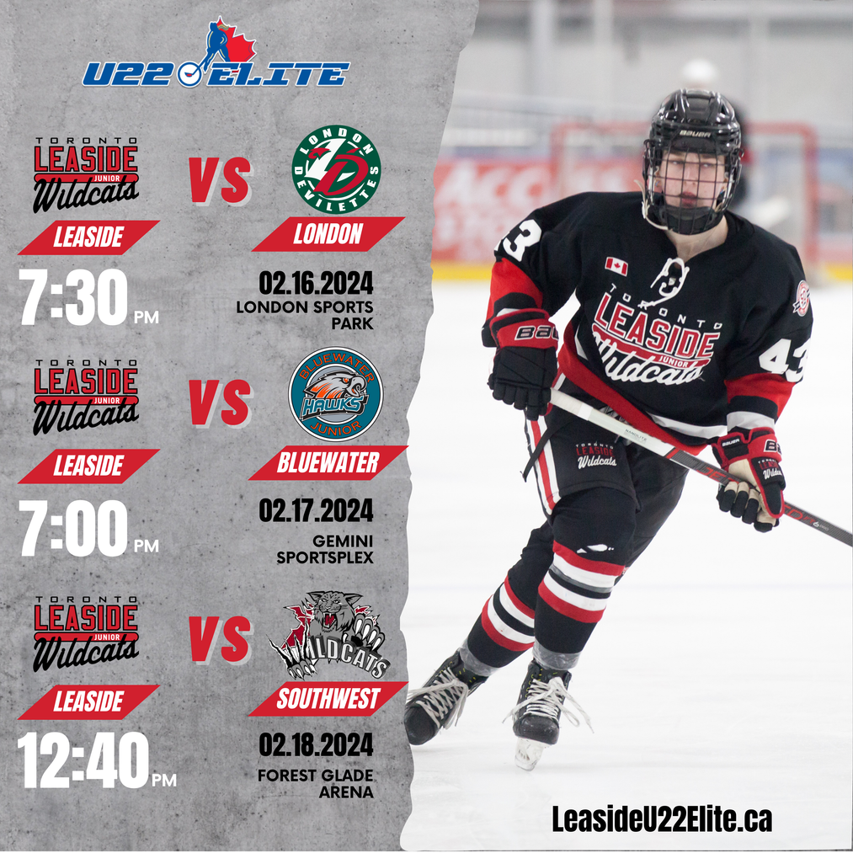
Weekend Preview
Posting weekly event previews and results from the week’s games. At times videos of game winning goals would be featured and a different player would be used in each post.
Seniors Night
Towards the end of the season, a series of posts was created to highlight our graduating senior players.
With each post featuring a different player leading up to the final home game of the season. Following the event, a recap post was shared to celebrate its success.

Slide 11
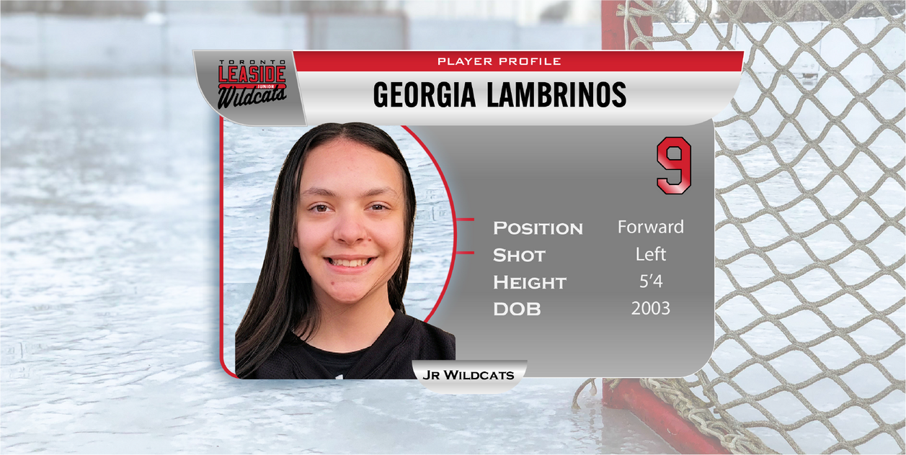

PROJECT
04
Player Profiles
Developing professional player profiles was essentials to strengthening the team’s brand and fostering a sense of pride and connection among the players and fans.
This image was applied to the team website. This could have also been used in any livestream webcasts of the game, or weekly player highlights.

Slide 12
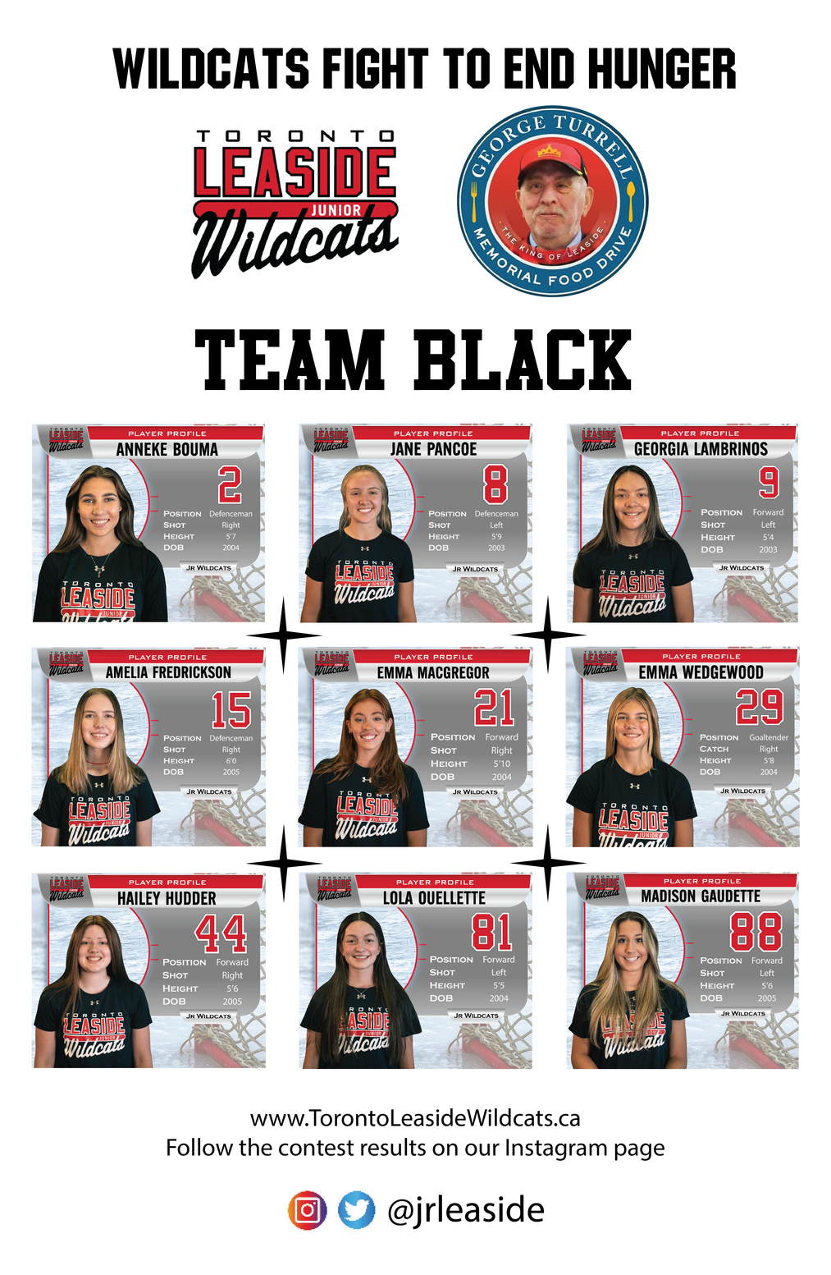
Player Profiles
Each season the team ran community initiatives to support local food banks or sock drives. This poster represented one team competing for the most amount of items for a local food drive.
Player profiles were used for various applications, including posters for the donation bins.
Trimming the photo to adjust the frame size allowed us to use multiple profiles for food drive posters.
Increasing visibility of the players around the rink provided more interaction with the youth members of the Association, encouraging following on social media and attending home games.

Slide 13
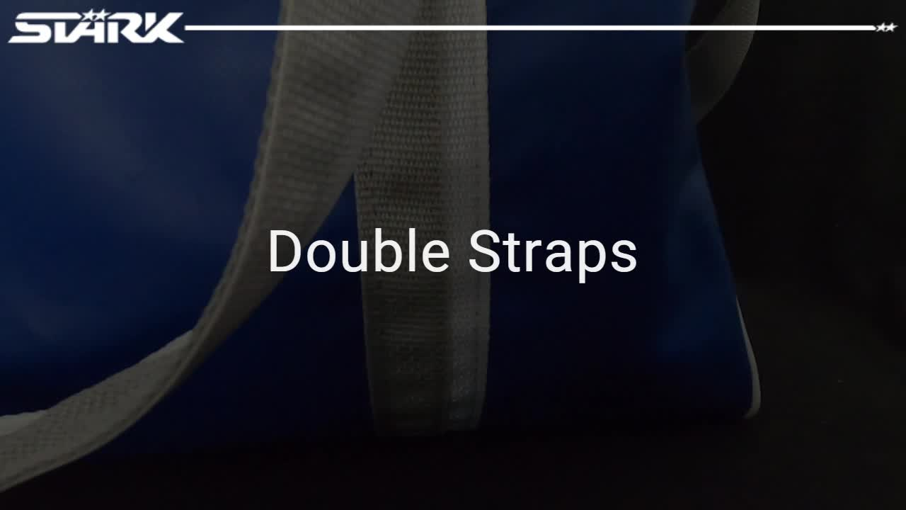
PROJECT
05
Product Video
At STÄRK, we launched a bag campaign to promote stock carry bags with a focus on durability and strength. The key message was, “Designed for players, built for life on the road’.
Featured is the extended video. We ran 3 shorter versions for our social media channels which focused on benefits and features of the bags.
A second campaign to begin in May will feature our custom team bags with an instructional video for youtube on using our web customizer to create your own custom team carry bag.

Slide 14
MICHELLE JANUS
LinkedIn Profile: michelle-janus-262
michelle.p.janus@gmail.com
(905) 512-5073

